Slide 1

Shri Vaishnav Vidyapeeth Vishwavidyalaya
Theory Of Computation(TOC)
BTCS-501
PRESENTED BY
Dishita Jain 18100BTBDAI02884
Radhika Gupta 18100BTBDAI02908
Shantanu More 18100BTBDAI02922
Vivek Maltare 18100BTBDAI02931
PRESENTED TO
Mr. Avdesh Kumar Sharma

Slide 2
P, NP , NP-COMPLETE and NP-HARD class of problems

Slide 3
Subtopics to be discussed
Basics Of Complexities
What is reduction?
P class of problems
NP class of problems
NP-HARD class of problems
NP -COMPLETE class of problems

Slide 4
1.
Basics Of Complexities
Let’s start with

Slide 5
What is Complexity?
Sometimes, there are more than one way to solve a problem. We need to learn how to compare the performance different algorithms and choose the best one to solve a particular problem.
While analyzing an algorithm, we mostly consider time complexity and space complexity.
Similarly, Space complexity of an algorithm quantifies the amount of space or memory taken by an algorithm to run as a function of the length of the input.
Time complexity of an algorithm quantifies the amount of time taken by an algorithm to run as a function of the length of the input.
Similarly, Space complexity of an algorithm quantifies the amount of space or memory taken by an algorithm to run as a function of the length of the input.

Slide 6
Order Of Growth
Order of growth is how the time of execution depends on the length of the input.
Order of growth will help us to compute the running time with ease . We use different notation to describe limiting behavior of a function.
Big-O Notation (O-notation)
Big-O notation represents the upper bound of the running time of an algorithm. Thus, it gives the worst-case complexity of an algorithm.
Big-O gives the upper bound of a function
O (g(n)) = { f(n): there exist positive constants c and n₀ such that 0 ≤ f(n) ≤ cg(n) for all n ≥ n₀ }
Omega Notation (Ω-notation)
Omega notation represents the lower bound of the running time of an algorithm. Thus, it provides the best case complexity of an algorithm.

Slide 7
Order Of Growth
Omega gives the lower bound of a function
Ω(g(n)) = { f(n): there exist positive constants c and n₀ such that 0 ≤ cg(n) ≤ f(n) for all n ≥ n₀ }
Theta Notation (Θ-notation)
Theta notation encloses the function from above and below. Since it represents the upper and the lower bound of the running time of an algorithm, it is used for analyzing the average-case complexity of an algorithm.
Theta bounds the function within constants factors For a function g(n), Θ(g(n)) is given by the relation:
Θ(g(n)) = { f(n): there exist positive constants c₁, c₂ and n₀ such that 0 ≤ c₁g(n) ≤ f(n) ≤ c₂g(n) for all n ≥ n₀ }

Slide 8
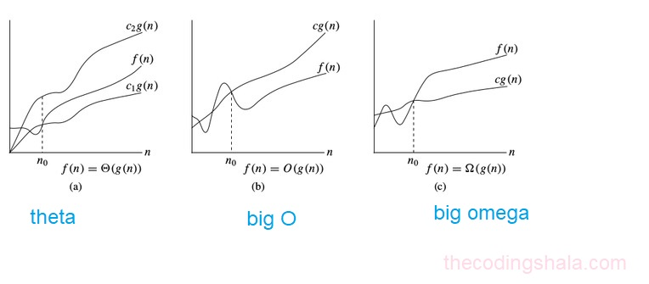
Diagramatic representation

Slide 9
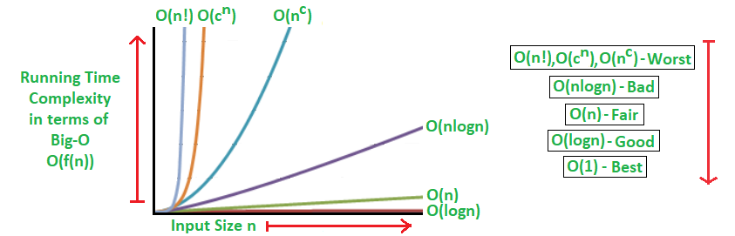
Basic complexities

Slide 10
2. what is reduction??

Slide 11
Reduction
What is a decision problem?
Decision Problem
There are many problems for which the answer is a Yes or a No. These types of problems are known as decision problems. For example,
Whether a given graph can be colored by only 4-colors.
What is Reduction?
Let R and Q be two decision problems.
A problem R can be reduced to another problem Q if any instance of R can be rephrased to an instance of Q, the solution to which provides a solution to the instance of R.
This rephrasing is called a transformation.
Intuitively: If R reduces in polynomial time to Q, R is “no harder to solve” than Q.

Slide 12
Reduction
suppose we have two decision problems p1 and p2
P1 problem :- input is I1 and Algorithm is A
P2 problem :- input is I2 and Algorithm is B
Suppose algorithm B can be used to solve Problem A.
Then , problem P1 is reducible to Problem P2 if there is a function which can convert input of A into input of B and solution of that instance provide solution to the problem.
Then we can say that P1 ∝ P2
Here we assume conversion cost is in polynomial time.
Example: lcm(m, n) = m * n / gcd(m, n), lcm(m,n) problem is reduced to gcd(m, n) problem

Slide 13
Reduction
I2
I1
F(x1)=I2
ALGORITHM B
OUTPUT
ALGORITHM A

Slide 14
P-Class

Slide 15
P-Class
P-Class
The class P consists of those problems that are solvable in polynomial time, i.e. these problems can be solved in time O(n^{k}) in worst-case, where k is constant.
These problems are called tractable, while others are called intractable or superpolynomial.
Formally, an algorithm is polynomial time algorithm, if there exists a polynomial p(n) such that the algorithm can solve any instance of size n in a time O(p(n)).
Problem requiring Ω(n⁵⁰) time to solve are essentially intractable for large n. Most known polynomial time algorithm run in time O(n^{k}) for fairly low value of k.
The advantages in considering the class of polynomial-time algorithms is that all reasonable deterministic single processor model of computation can be simulated on each other with at most a polynomial slow-d

Slide 16
P-Class
Polynomial algorithms like logarithmic, linear or quadratic time.
All basic mathematical operations; addition, subtraction, division, multiplication
Testing for primacy
Hashtable lookup, string operations, sorting problems
Shortest Path Algorithms; Djikstra, Bellman-Ford, Floyd-Warshall
Linear and Binary Search Algorithms for a given set of numbers
All of these have a complexity of O(n^k) for some k, and that fact places them all in P. Of course, we don’t always have just one input, n.
But, so long as each input is a polynomial, multiplying them will still be a polynomial.

Slide 17
P-Class
For example, in graphs, we use E for edges and V for vertices, which gives us O(E * V) for Bellman-Ford’s shortest path algorithm. Even if the size of the edge set is E = V^2, the time complexity is still a polynomial, O(V^3), so we’re still in P.
Examples of Problems in P
● All regular languages are in P.
● All CFLs are in P.

Slide 18
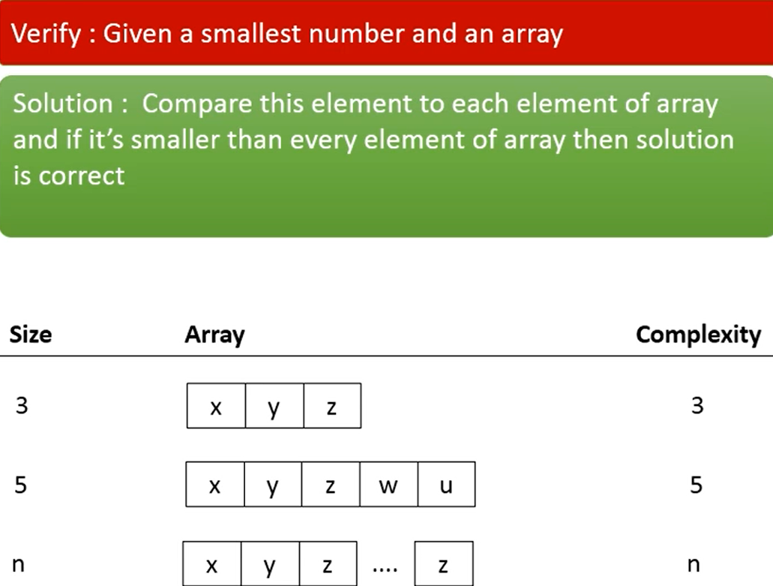
Example

Slide 19
Problems of P
Problems in P
● Graph connectivity: Given a graph G and nodes s and t, is there a path from s to t?
● Primality testing: Given a number p, is p prime? (Best known TM for this takes time O(n37).)
● Maximum matching: Given a set of tasks and workers who can perform those tasks, if each worker performs exactly one task, can at least n tasks be performed?
● Remoteness testing: Given a graph G, are all of the nodes in G within distance at most k of one another?
● Linear programming: Given a linear set of constraints and linear objective function, is the optimal solution at least n?
● Edit distance: Given two strings, can the strings be transformed into one another in at most n single-character edits?

Slide 20
NP-Class

Slide 21
NP-Class
The second set of problems cannot be solved in polynomial time. However, they can be verified in polynomial time. For example,
Integer Factorization and
Graph Isomorphism
Both of these have two important characteristics: Their complexity is for some and their results can be verified in polynomial time. Those two facts place them all in , that is, the set of “Non-deterministic Polynomial” algorithms. Now, formally, we also state that these problems must be decision problems – all function problems can be transformed into decision problems.
An algorithm is in if it can’t be solved in polynomial time and the set of solutions to any decision problem can be verified in polynomial time by a “Deterministic Turing Machine“.

Slide 22
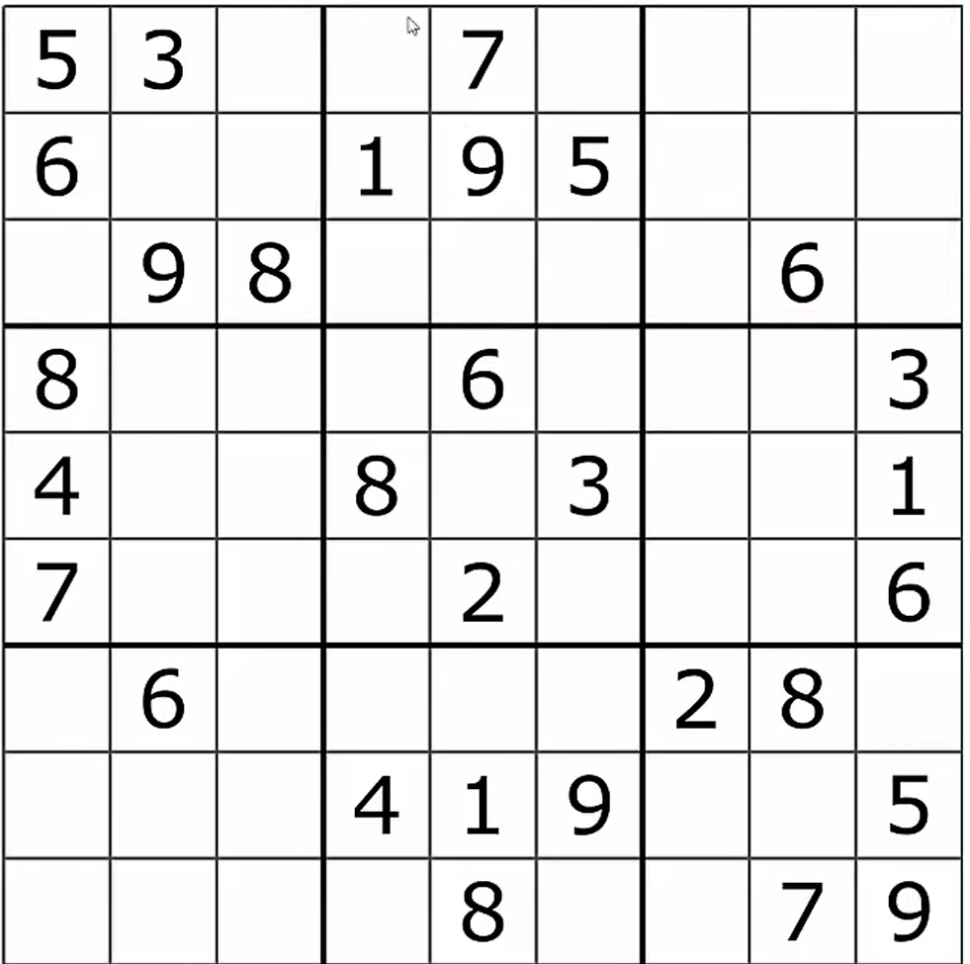
Example

Slide 23
Problems of NP
Problem in NP
1) A k-coloring of an undirected graph G is a way of assigning one if k colors to each node in G such that no two nodes joined by an edge have the same color.
● Applications in compilers, cell phone towers, etc.
● Question: Given a graph G and a number k, is graph G k-colorable?
● M = “On input ⟨G, k⟩:
● Nondeterministically guess a k-coloring of the nodes of G.
● Deterministically check whether it is legal.
● If so, accept; if not, reject.”
2) Subset sum: Given a set S of natural numbers and a target number n, is there a subset of S that sums to n?

Slide 24
Problems of NP
3) Longest path: Given a graph G, a pair of nodes u and v, and a number k, is there a simple path from u to v of length at least k?
4) Job scheduling: Given a set of jobs J, a number of workers k, and a time limit t, can the k workers, working in parallel complete all jobs in J within time t?

Slide 25
Difference
P PROBLEMS | NP PROBLEMS
P problems are set of problems which can be solved in polynomial time by deterministic algorithms. | NP problems are the problems which can be solved in non-deterministic polynomial time.
The problem belongs to class P if it’s easy to find a solution for the problem. | The problem belongs to NP, if it’s easy to check a solution that may have been very tedious to find.
P Problems can be solved and verified in polynomial time. | Solution to NP problems cannot be obtained in polynomial time, but if the solution is given, it can be verified in polynomial time.
P problems are subset of NP problems. | NP problems are superset of P problems.
It is not known whether P=NP. However, many problems are known in NP with the property that if they belong to P, then it can be proved that P=NP. | If P≠NP, there are problems in NP that are neither in P nor in NP-Complete.
All P problems are deterministic in nature. | All the NP problems are non-deterministic in nature.
Selection sort, linear search | TSP, Knapsack problem.

Slide 26
NP HARD

Slide 27
NP HARD
This set of problems contains the hardest, most complex problems in computer science.
They are not only hard to solve but are hard to verify as well. These algorithms have a property similar to ones in NP-Complete- they can all be reduced to any problem in NP. Because of that these are in NP-Hard and are at least as hard as any other problem in NP
Simply, A problem is classified as NP-Hard when an algorithm for solving it can be reduced to solve any NP problem. Hence NP-Hard problems are at least as hard as NP problem, but could be much harder or more complex .

Slide 28
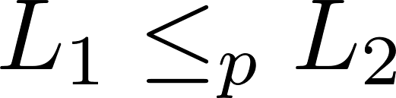
NP HARD
This notation means that L₁ is reducible in polynomial time to L₂ .
The less than symbol basically means that the time taken to solve L₁ is no worse than that a polynomial factor away from the time taken to solve L₂.

Slide 29
NP HARD
A problem (a language) is said to be NP-hard if every problem in NP can be poly time reduced to it.

Slide 30
Clique Decision Problem

Slide 31
Clique Decision Problem
In an undirected graph, a clique is a sub-graph of the given graph.
A problem L belongs to NP-Hard if every NP problem is reducible to L in polynomial time. Now, let the Clique Decision Problem be represented by C. To prove that C is NP-Hard, we take an already known NP-Hard problem, say S, and reduce it to C for a particular instance. If this reduction can be done in polynomial time, then C is also an NP-Hard problem.

Slide 32
Proof that the Boolean Satisfiability problem reduces to the Clique Decision Problem
Let the boolean expression be – F = (x₁ v x₂) ^ (x₁‘ v x₂‘) ^ (x₁ v x₃)
where x₁, x₂, x₃ are the variables, ‘^’ denotes logical ‘and’, ‘v’ denotes logical ‘or’ and x’ denotes the complement of x.
Let the expression within each parentheses be a clause. Hence we have three clauses – C₁, C₂ and C₃.
Consider the vertices as – <x₁, 1>; <x₂, 1>; <x₁’, 2>; <x₂’, 2>; <x₁, 3>; <x₃, 3> where the second term in each vertex denotes the clause number they belong to.

Slide 33
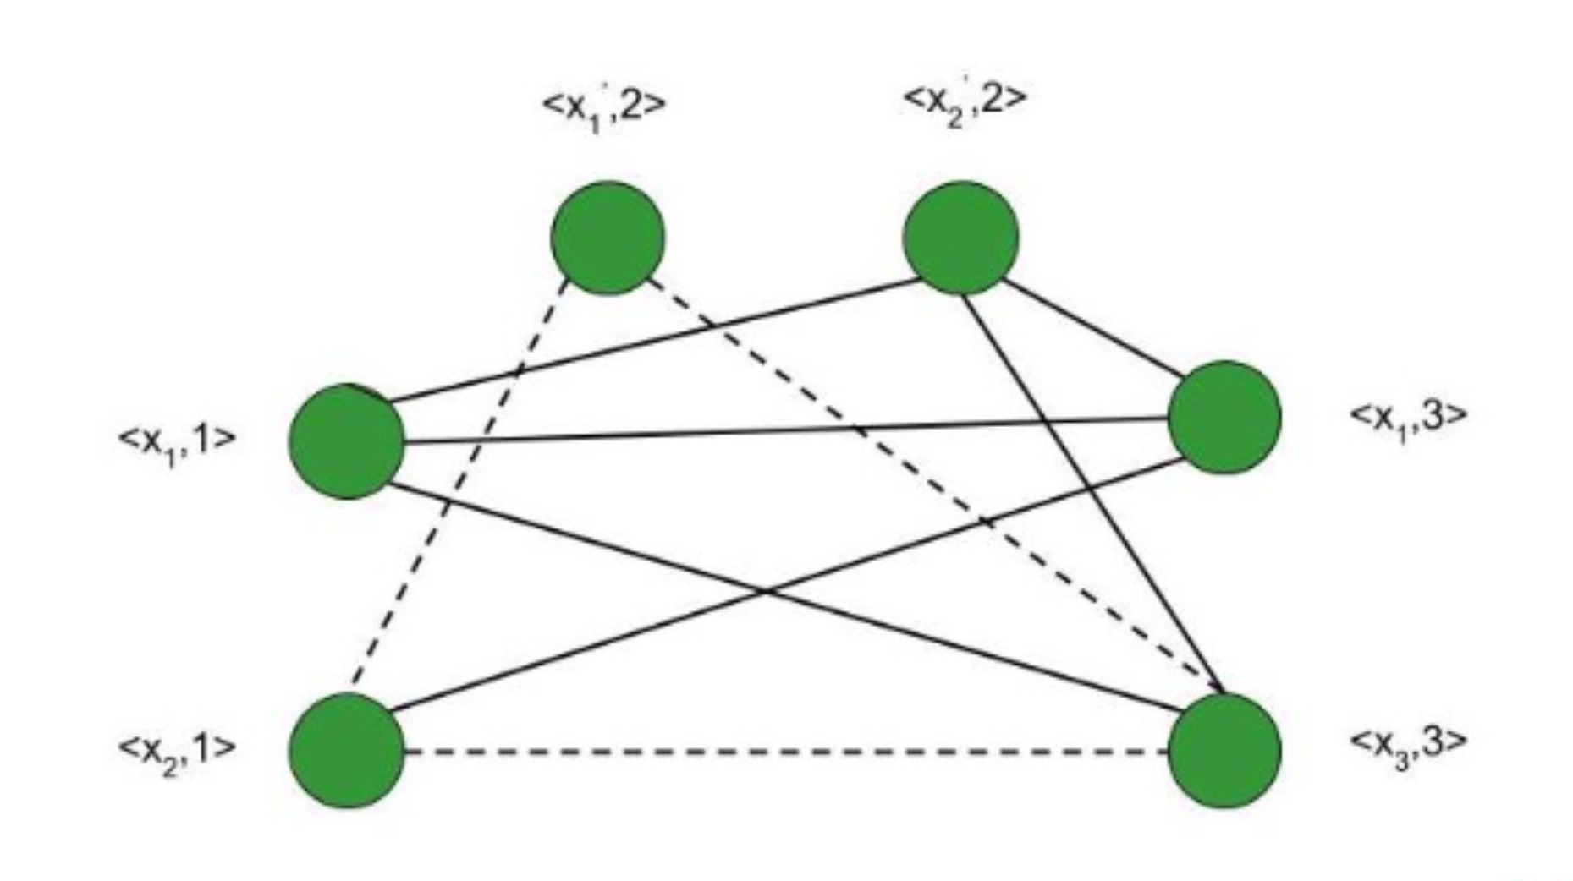
Clique Decision Problem
We connect these vertices such that –
No two vertices belonging to the same clause are connected.
No variable is connected to its complement.

Slide 34
Clique Decision Problem
Consider the subgraph of G with the vertices <x₂, 1>; <x₁’, 2>; <x₃, 3>. It forms a clique of size 3 (Depicted by dotted line in the figure) . Corresponding to this, for the assignment – <x₁, x₂, x₃> = <0, 1, 1> F evaluates to true.

Slide 35
Clique Decision Problem
Therefore, if we have k clauses in our satisfiability expression, we get a max clique of size k and for the corresponding assignment of values, the satisfiability expression evaluates to betrue. Hence, for a particular instance, the satisfiability problem is reduced to the clique decision problem.
Therefore, the Clique Decision Problem is NP-Hard.

Slide 36
NP-COMPLETE

Slide 37
NP-COMPLETE
A language B is NP-complete if it satisfies two conditions
- B is in NP
- Every A in NP is polynomial time reducible to B.
If a language satisfies the second property, but not necessarily the first one, the language B is known as NP-Hard. Informally, a search problem B is NP-Hard if there exists some NP-Complete problem A that Turing reduces to B.

Slide 38
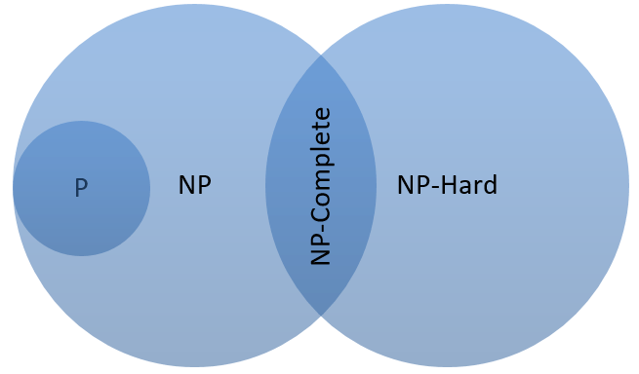
NP-COMPLETE

Slide 39
NP-COMPLETE
L is NP-complete if
-L ϵ NP and
-L is NP-hard
If any NP-complete problem is solvable in polynomial time, then every NP-Complete problem is also solvable in polynomial time.
Conversely, if we can prove that any NP-Complete problem cannot be solved in polynomial time, every NP-Complete problem cannot be solvable in polynomial time.

Slide 40
Cook’s Theorem

Slide 41
Cook’s Theorem
NP=P if and only if the satisfiability problem is a P problem
Sat is NP-complete
It is the first NP-complete problem
Every NP-problem reduces to SAT.

Slide 42
Proof that SAT is NP Complete
SAT Problem:
SAT(Boolean Satisfiability Problem) is the problem of determining if there exists an interpretation that satisfies a given Boolean formula.
It asks whether the variables of a given boolean formula can be consistently replaced by the values TRUE or FALSE in such a way that the formula evaluates to TRUE. If this is the case, the formula is called satisfiable.
On the other hand, if no such assignment exists, the function expressed by the formula is FALSE for all possible variable assignments and the formula is unsatisfiable.

Slide 43
Proof that SAT is NP Complete
Problem:
Given a Boolean formula f, the problem is to identify if the formula f has a satisfying assignment or not.
Explanation:
An instance of the problem is an input specified to the problem. An instance of the problem is a Boolean formula f. Since an NP-complete problem is a problem which is both NP and NP-Hard, the proof or statement that a problem is NP-Complete consists of two parts:
The problem itself is in NP class.
All other problems in NP class can be polynomial-time reducible to that. (B is polynomial-time reducible to C is denoted as ≤ P^{C})

Slide 44
Proof that SAT is NP Complete
If the 2nd condition is only satisfied then the problem is called NP-Hard.
But it is not possible to reduce every NP problem into another NP problem to show its NP-Completeness all the time i.e., to show a problem is NP-complete then prove that the problem is in NP and any NP-Complete problem is reducible to that i.e. if B is NP-Complete and B ≤ P^{C} For C in NP, then C is NP-Complete.
Thus, it can be verified that the SAT Problem is NP-Complete using the following propositions:
- SAT is in NP
- SAT is NP-Hard

Slide 45
Proof that SAT is NP Complete
SAT is in NP
If any problem is in NP, then given a ‘certificate’, which is a solution to the problem and an instance of the problem(a boolean formula f) we will be able to check (identify if the solution is correct or not) certificate in polynomial time.
This can be done by checking if the given assignment of variables satisfies the boolean formula.

Slide 46
Proof that SAT is NP Complete
SAT is NP-Hard:
In order to prove that this problem is NP-Hard then reduce a known problem, Circuit-SAT in this case to our problem. The boolean circuit C can be corrected into a boolean formula as:
- For every input wire, add a new variable y_{i.}
- For every output wire, add a new variable Z.
- An equation is prepared for each gate.
- These sets of equations are separated by ∩ values and adding ∩Z at the end.
This transformation can be done in linear time. The following propositions now hold:
If there is a set of input, variable values satisfying the circuit then it can derive an assignment for the formula f that satisfies the formula. This can be simulated by computing the output of every gate in the circuit.
If there is a satisfying assignment for the formula f, this can satisfy the boolean circuit after the removal of the newly added variables.

Slide 47
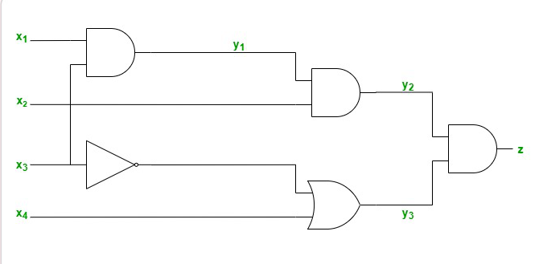
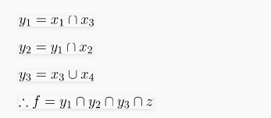
Proof that SAT is NP Complete
For Example: If below is the circuit then:
Therefore, the SAT Problem is NP-Complete.

Slide 48
THANK YOU

